Slide 1

Software requirements (swr302)
UNDERSTANDING USER REQUIREMENTS (chapter 08)

Slide 2
Use cases and user stories
A use case describes a sequence of interactions between a system and an external actor that results in the actor being able to achieve some outcome of value
The names of use cases are always written in the form of a verb followed by an object.
Select strong, descriptive names to make it evident from the name that the use case will deliver something valuable for some user

Slide 3
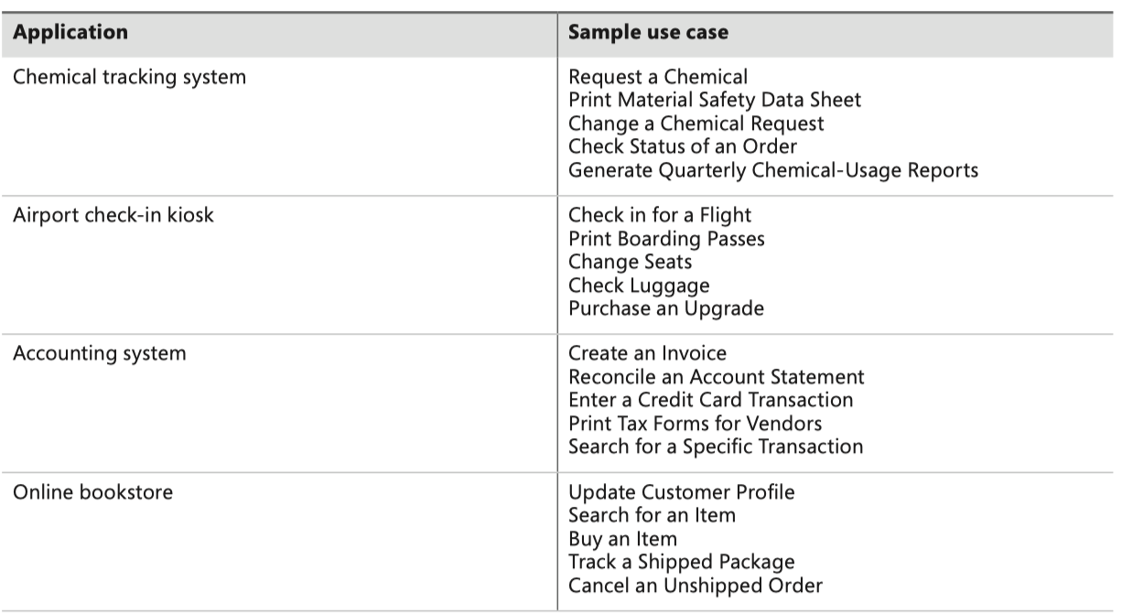
Use cases and user stories
Sample use cases from various applications

Slide 4
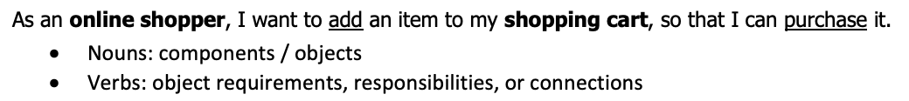
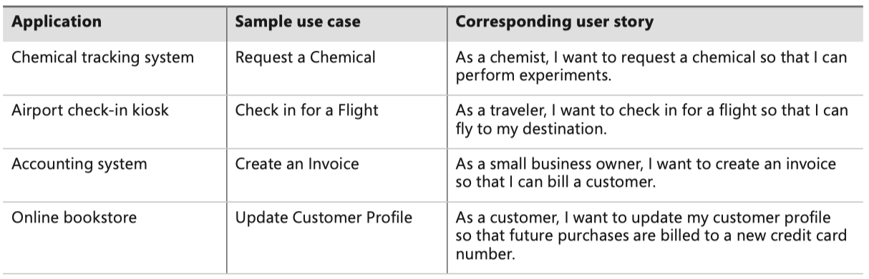
Use cases and user stories
As used on agile development projects, a user story is a “short, simple description of a feature told from the perspective of the person who desires the new capability, usually a user or customer of the system”
User stories often are written according to the following template, although other styles also are used:
As a <type of user>, I want <some goal> so that <some reason>.
Notes:
Blank1: user role
Blank2: put that goal that the user role wants to achieve => feature to implement
Blank3: put the reason why the user role wants this goal (can be omitted if the benefits are clear and generally known)

Slide 5
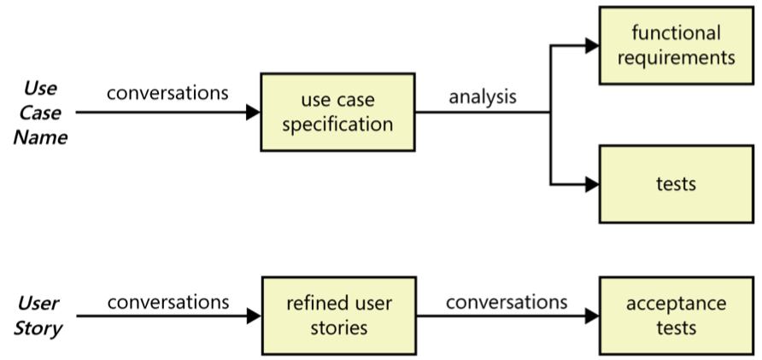
Use cases and user stories
Both are focused on understanding what different types of users need to accomplish through interactions with a software system
However, the two processes move in different directions from these similar starting points

Slide 6
The use case approach
Questions to consider
What will the actor use the system for?
Will the actor create, store, change, remove, or read data in the system?
Will the actor need to inform the system about external events or changes?
Will the actor need to be informed about certain occurrences in the system?
Provide a brief description that elaborates the intent of the use case
Program Vacation Setting
Actor(s): Homeowner/programmer
Description: Homeowner/programmer sets lighting and alarm options for an extended stay away from home

Slide 7
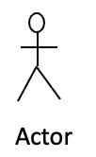
The use case approach The system actors
An actor is a person (or sometimes another software system or a hardware device) that interacts with the system to perform a use case
Who (or what) is notified when something occurs within the system?
Who (or what) provides information or services to the system?
Who (or what) helps the system respond to and complete a task?
Users
Students are actors on EduNext system
Authors are actors on a word processing system
Other systems or applications
The EduNext system is the actor of the FAP system.
A device
Camera
Printer

Slide 8
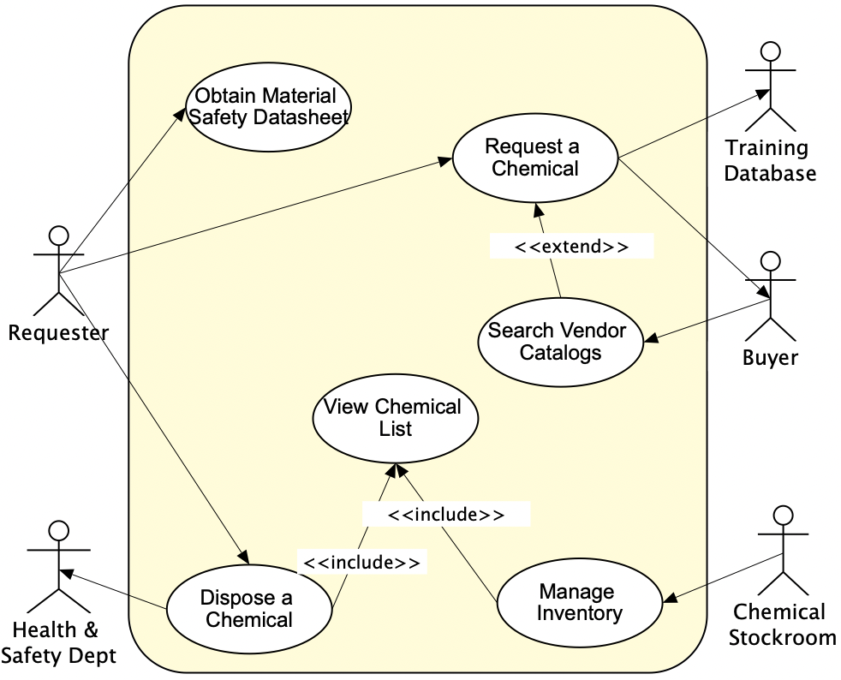
The use case approach The use case diagrams
The diagrams provide a high-level visual representation of the user requirements
The primary actor initiates the use case and derives the main value from it
An arrow goes from a use case to a secondary actor, who participates somehow in the successful execution of the use case.

Slide 9
The use case approach The use case specification
Mandatory elements
Name – Unique and descriptive
Brief description – Paragraph describing purpose
Actors – List all actors that interact with this use case
Flow of events – Basic flow and Alternate flows
Optional elements
Pre-conditions – conditions that must be present in order for a use case to start
Post-condition – state of the system after a use case has run its course
System or subsystem – level of use case. System causes multiple subsystems to interact
Other stakeholder – non users
Special requirements – performance or throughput

Slide 10
The use case approach Outline the use cases
Outline all the basic flows first
Basic flow is the most common path
What event starts the use case?
How does the use case end?
How does the use case repeat some behavior?
Outline alternate flows
Are there optional situations?
What odd cases might happen?
What variants might happen?
What may go wrong?
What may not happen?
What kind of resources can be blocked?

Slide 11


